Slide 1
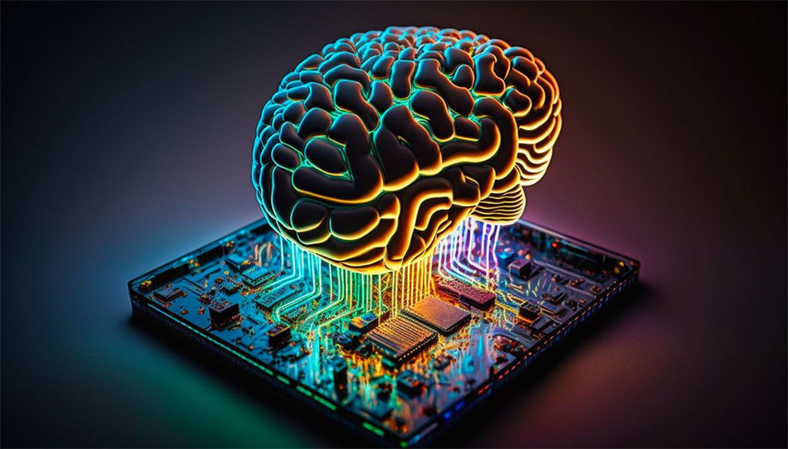
Neuromorphic Computing: An In-Depth Exploration

Slide 2
Introduction

Slide 3
Neuromorphic Computing: A New Paradigm
Definition: Neuromorphic computing aims to mimic the structure and functions of biological neural systems to create more brain-like, efficient computing architectures.
Relevance:
  Addresses limitations of traditional computing, particularly as Moore's Law approaches physical limits.
  Offers solutions for energy efficiency and adaptive learning needed in AI and machine learning applications.
Key Drivers:
  Growing demand for high-efficiency, low-power computing, especially in AI-driven tasks.
  Interest in systems that can perform real-time data processing and sensory integration, as biological brains do​.

Slide 4
Motivation and Goals
Why It Matters:
  Traditional architectures struggle with energy demands and scalability for complex tasks.
  Neuromorphic computing could revolutionize fields requiring real-time, adaptive processing like robotics, IoT, and brain-computer interfaces.
Goal of Neuromorphic Computing:
  To create systems capable of massive parallel processing and self-learning similar to human brains, potentially opening new frontiers in computing power and application diversity

Slide 5
Historical Context and Theoretical Foundations

Slide 6
Origins of Neuromorphic Computing
Concept Introduced:
  Carver Mead (1980s): Proposed neuromorphic computing, envisioning Very-Large-Scale Integration (VLSI) systems that mimic biological neural networks.
  Inspired by the brain's structure to create systems that process information in a massively parallel, energy-efficient manner.
Theoretical Foundations from Neuroscience
Neuron Doctrine (Santiago Ramón y Cajal):
  Established that the brain is composed of individual neurons that communicate through synapses.
  This understanding serves as a basis for modeling interconnected, spiking neurons in neuromorphic systems​

Slide 7
Significance of Neuromorphic Foundations
Shift from Traditional Computing
  Traditional computing relies on von Neumann architecture, with separate memory and processing units, causing potential bottlenecks.
  Neuromorphic systems integrate memory and processing, inspired by biological efficiency, allowing asynchronous and event-driven processing that reduces power usage and improves speed

Slide 8
Principles of Neuromorphic Computing

Slide 9
Biological Inspirations
1. Massive Parallelism
Human Brain Model: The brain operates with approximately 86 billion neurons, each connected to thousands of others, which enables highly efficient, simultaneous processing.
Parallel Processing: Neuromorphic systems aim to replicate this ability, processing multiple streams of information concurrently rather than sequentially, as in traditional computing.
2. Low Power Consumption
Brain Efficiency: The human brain uses only about 20 watts of power to perform complex tasks, an efficiency level far beyond that of current digital systems.
Neuromorphic Goal: Neuromorphic computing seeks to emulate this low power usage by optimizing for event-driven and asynchronous processing, which means computing only when necessary.

Slide 10
Core Characteristics of Neuromorphic Systems
1. Spiking Neural Networks (SNNs)
Mimicking Biological Neurons: Unlike traditional artificial neural networks, SNNs transmit information in discrete spikes, similar to the way biological neurons communicate.
Asynchronous Signals: These spikes represent asynchronous, event-based signals, where information is transmitted only when necessary, improving both efficiency and real-time processing.
2. Event-Driven Processing
Energy-Efficient Processing: Neuromorphic systems use event-driven architectures, meaning they only process data when triggered by an event (e.g., a sensory input) instead of continuously.
Applications: This approach reduces power consumption and makes neuromorphic systems ideal for real-time applications, such as robotics and IoT sensors, where energy efficiency is crucial.

Slide 11
In-Memory Computing and Its Advantages
1. Overcoming the von Neumann Bottleneck
Traditional Bottleneck: Traditional computing architectures separate memory and processing, leading to delays and energy costs as data moves between them.
In-Memory Processing: Neuromorphic systems integrate memory and processing units, inspired by the brain’s structure, which allows for faster, more efficient computation by eliminating the need for constant data shuttling.
2. Real-Time Processing Benefits
Immediate Data Handling: In-memory computing enables neuromorphic systems to process information as soon as it’s received, supporting applications that require quick decision-making.
Examples: Real-time object recognition in autonomous vehicles and fast response in robotics.

Slide 12
Advantages Over Traditional Computing
1. Improved Energy Efficiency
Lower Power Requirements: Due to their event-driven nature and in-memory processing, neuromorphic systems use significantly less power than traditional architectures, especially in tasks requiring continuous learning and adaptation.
Sustainability Impact: Reduced energy consumption has broader applications for sustainable computing, especially in mobile and remote environments.
2. Adaptive and Real-Time Applications
Enhanced Suitability: Neuromorphic systems excel in adaptive, real-time applications where data inputs and environments change rapidly.
Examples: Robotics, sensory processing, and autonomous systems, where neuromorphic architectures provide a clear advantage over traditional, sequential processing methods.

Slide 13
Hardware Implementations and Applications

Slide 14
Digital Implementations
1. IBM’s TrueNorth Chip
Design: Contains 1 million digital neurons and 256 million synapses in a parallel, distributed array, making it one of the first large-scale digital neuromorphic chips.
Features: Designed for pattern recognition and low-power processing, TrueNorth can handle complex tasks with a fraction of the energy used by traditional processors.
2. Intel’s Loihi Chip
Scalable Architecture: Supports up to 16 million neurons and includes on-chip learning capabilities, allowing it to adapt and learn in real-time.
Key Benefits: Loihi is energy-efficient, scalable, and ideal for tasks requiring continuous learning and adaptability, such as robotics and autonomous navigation.

Slide 15
Brain-Computer Interfaces (BCIs)
1. Enhanced Signal Processing
Neuromorphic Strengths: Neuromorphic systems are well-suited for interpreting complex brain signals, improving the accuracy and efficiency of BCIs.
Example: BCIs for prosthetics can use neuromorphic chips to translate brain activity into more natural and precise movements
2. Bidirectional Interfaces for Control and Feedback
Natural Interaction: Neuromorphic systems can enable two-way communication between a human brain and a computer, allowing for feedback and control.
Example: In medical applications, BCIs with bidirectional communication can provide sensory feedback to patients with prosthetics, improving control and comfort.

Slide 16
Challenges, Future Directions, and Conclusion

Slide 17
Current Challenges
1. Scaling and Complexity
Scaling Up Systems: Creating large-scale neuromorphic systems with neuron counts approaching biological complexity is a major challenge, particularly in hardware fabrication.
Connectivity Issues: Ensuring effective communication between vast numbers of neurons and synapses requires advances in chip design and interconnect technology​
2. Programming Paradigms
Lack of Established Models: Traditional programming methods do not easily translate to neuromorphic systems, necessitating new frameworks for asynchronous, spike-based processing.
Tools and Languages: Developing intuitive programming languages and tools specific to neuromorphic architectures is crucial for broader adoption
3. Benchmarking and Evaluation
Performance Metrics: Neuromorphic systems need new performance benchmarks to properly evaluate their effectiveness compared to traditional computing.
Standardization: Establishing standardized metrics is essential for fair comparison and continued progress in the field.

Slide 18
Future Directions in Research
1. Advanced Programming Models
Spiking Neural Network Frameworks: Further development of frameworks like Nengo and Brian can help bridge the gap between theoretical neuromorphic models and real-world applications.
Event-Driven Programming: Research into asynchronous programming models suited for event-driven architectures will improve neuromorphic software development​.
2. New Learning Algorithms
Spike-Timing-Dependent Plasticity (STDP): STDP and other biologically inspired learning rules can enhance the adaptability of neuromorphic systems for unsupervised learning tasks.
Surrogate Gradient Methods: Techniques like surrogate gradients may enable more effective supervised learning in spiking neural networks​

Slide 19
Conclusion and Future Prospects
1. Summary of Neuromorphic Computing’s Potential
Transformative Shift: Neuromorphic computing represents a major shift from traditional architectures, providing solutions for high-efficiency, adaptive, and real-time processing.
Diverse Applications: Potential impact in fields like AI, robotics, autonomous systems, healthcare, and environmental monitoring.
2. Long-Term Implications
Shaping the Future of Technology: As neuromorphic technologies mature, they will likely drive advancements across multiple domains, enabling intelligent systems capable of complex decision-making and learning.
Interdisciplinary Collaboration: Continued growth in neuromorphic computing will require collaboration between fields like neuroscience, engineering, computer science, and materials science.

Slide 20
Thank You

